Slide 1

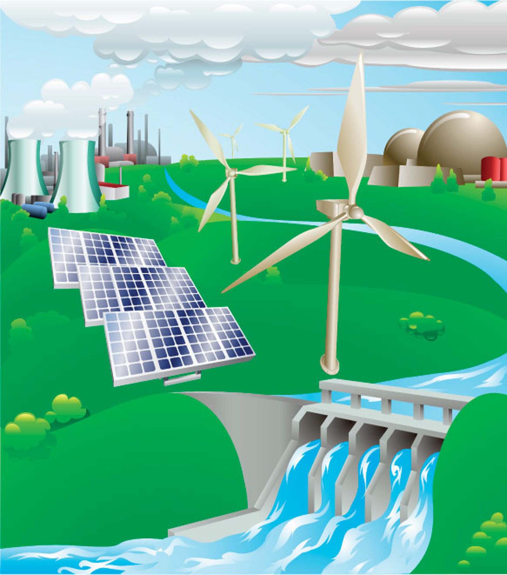
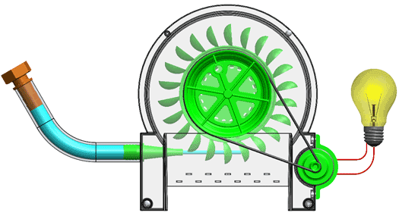

Sources
of
Energy
María Liste

Slide 2
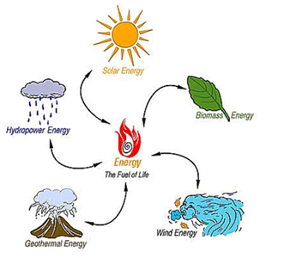
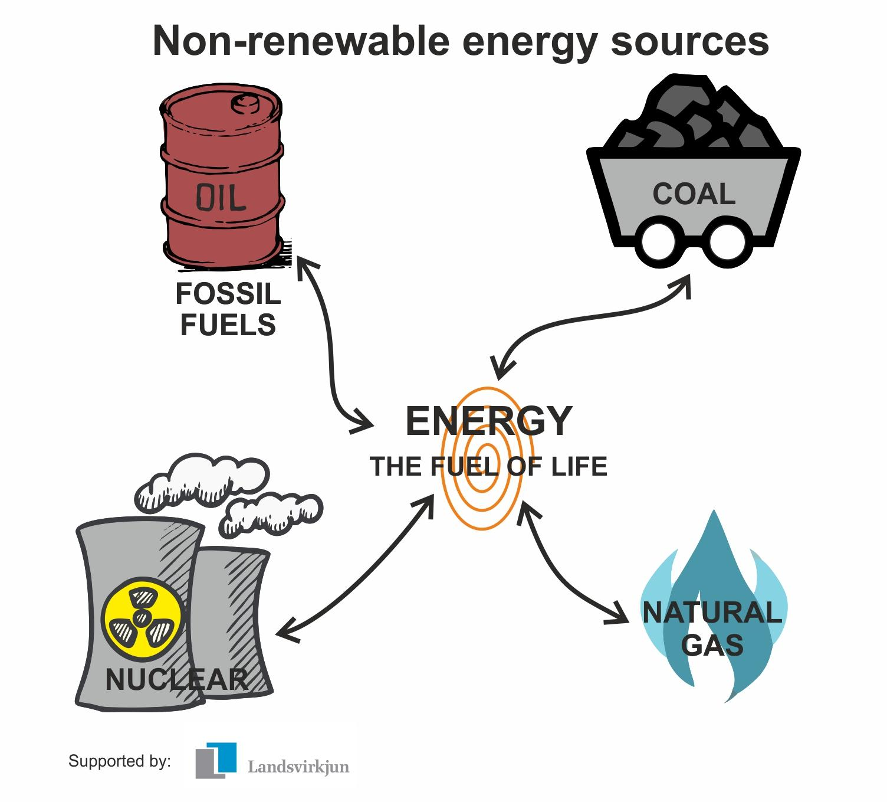
We use many different energy sources to do work.
Energy sources are classified
into two groups:
Renewable energy sources
Non-Renewable energy sources

Slide 3
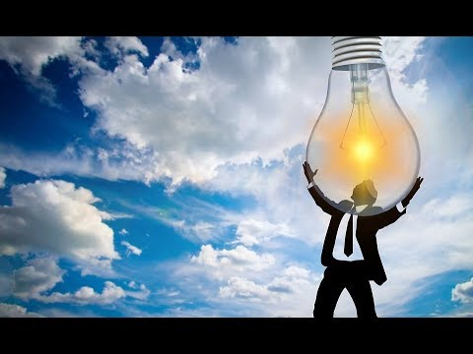
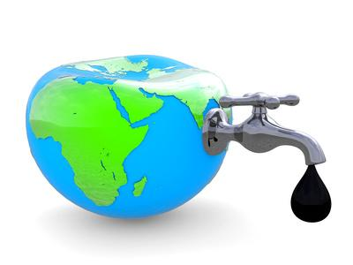
A renewable resource
is a natural resource
that can be replaced
in a short period of time.
A non-renewable resource
is a natural resource
that cannot be replaced
in a short period of time.
It can be replaced only
over thousands or millions of years.
It is unlimited.

Slide 4
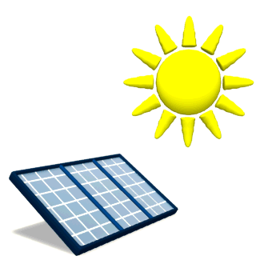
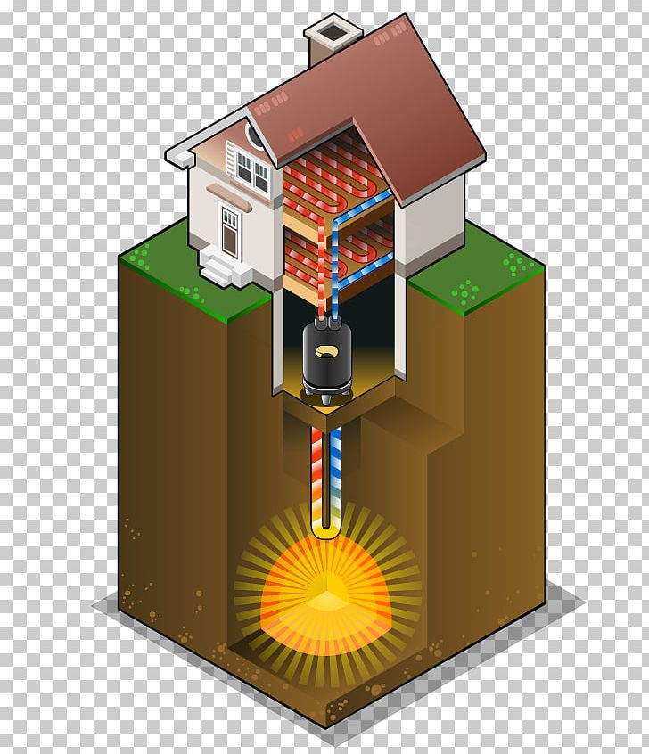
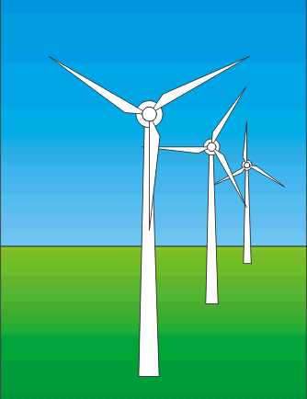
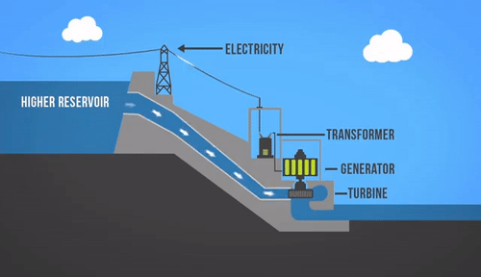
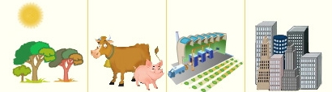
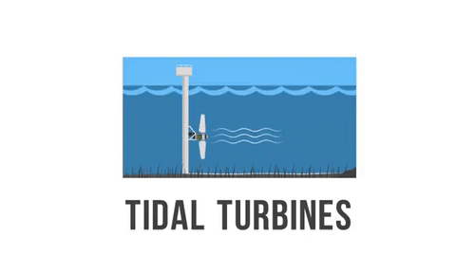
Renewable Energy Sources
The Geothermal Heat
The Wind
The Water
The Sun
The Biomass
The Tides
Waste from plants, animals, factories, the cities...

Slide 5
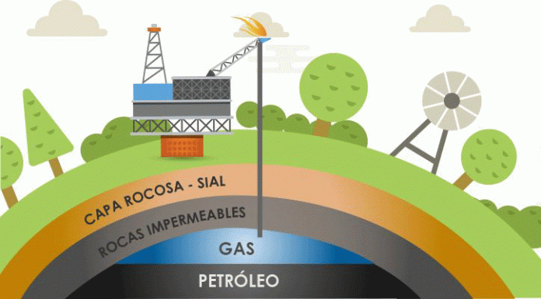
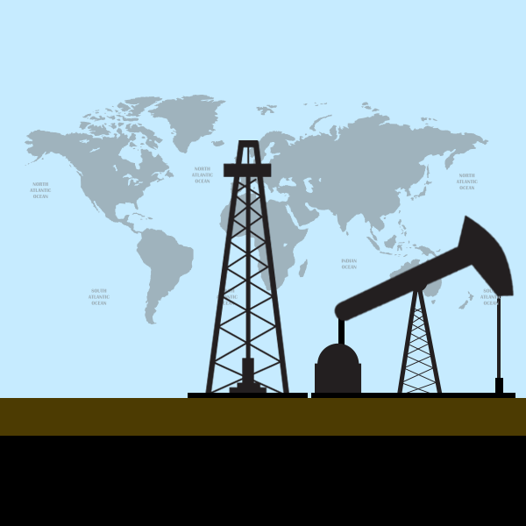
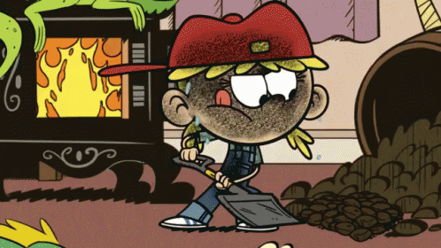
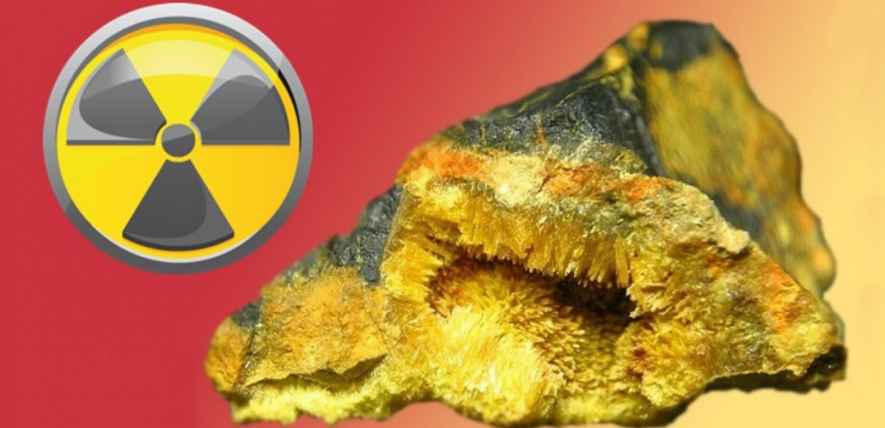
Non-renewable Energy Sources
Natural gas
Crude oil
Fossil
fuels
Coal
Uranium (radioactive mineral)

Slide 6
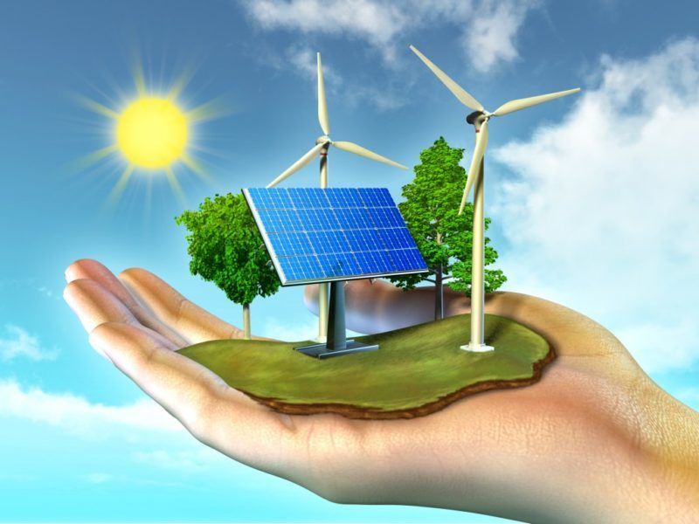
Renewable

Slide 7
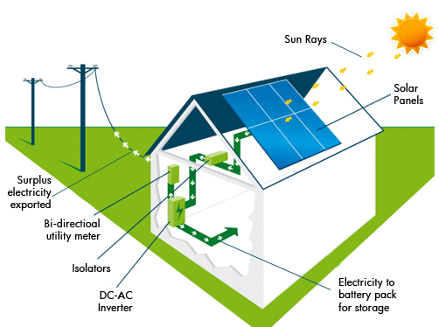
Solar Energy
We use solar panels to get energy from the sun.
Photovoltaic solar panels
turn sunlight
into electricity.

Slide 8
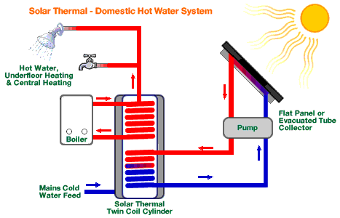
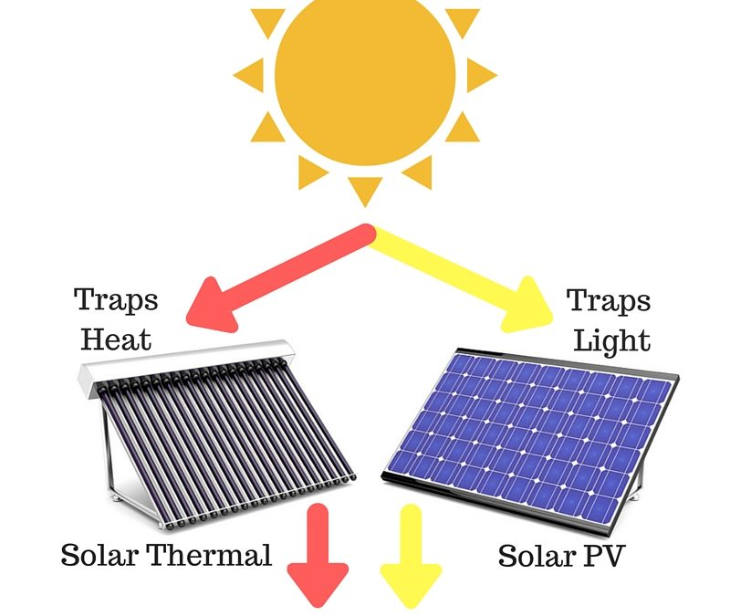
Thermal solar panels
turn sunlight
into heat.
(Solar collectors)
Solar
collector
Tank

Slide 9

Solar Energy
ADVANTAGES
DISADVANTAGES
It does not produce any carbon dioxide emissions.
It will not run out: the sun shines every day and it is free. Solar panels are easy to maintain
Solar panels don’t make any noise
Solar panels are expensive to make.
Solar panels don’t produce electricity at night
Solar panels take up much space.
We need a lot of solar panels to make a lot of electricity..

Slide 10
Hydro-electric Energy
We use hydroelectric power stations to get energy from the water.
Hydropower stations
turn the force of
falling water
into electricity.
How do they do it?

Slide 11
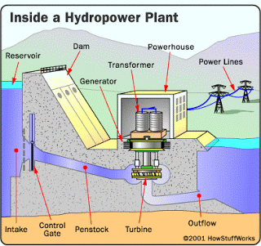
This is how it works:
Dam: stores water
Penstock: carries the water to the turbine
The force of the water rotates the turbine
The turbine is connected to a generator (by a rotating shaft)
The generator spins creating electricity!!
Electricity is sent to the power lines
Shaft

Slide 12
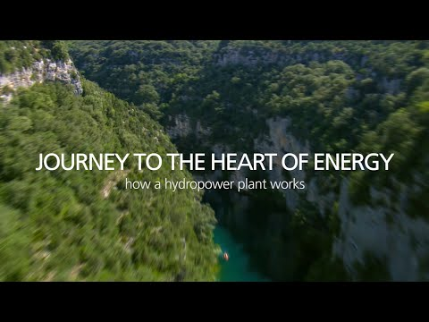

Slide 13
Hydropower Energy
ADVANTAGES
DISADVANTAGES
It does not produce any carbon dioxide emissions.
It does not pollute the water.
It will not run out: rainfall renews the water in the reservoir and it is free.
Electricity can be generated 24 hours a day as long as there is enough water.
It is very expensive to build a dam.
When a dam is built, a huge area is flooded to make a reservoir. The water displaces the people and animals living there.
It can be difficult to find a suitable site for a reservoir or a dam.
The production of electricity can be affected by lack of water: if it does not rain, we may not have enough water in the reservoir.

Slide 14
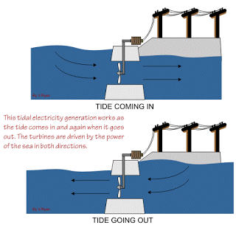
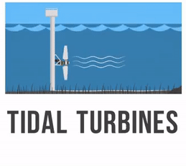
Tydal Energy
Tidal Power is similar to how hydroelectric power is generated.
When the tide goes in and out, the flowing water is used to turn turbines and generate electricity.

Slide 15
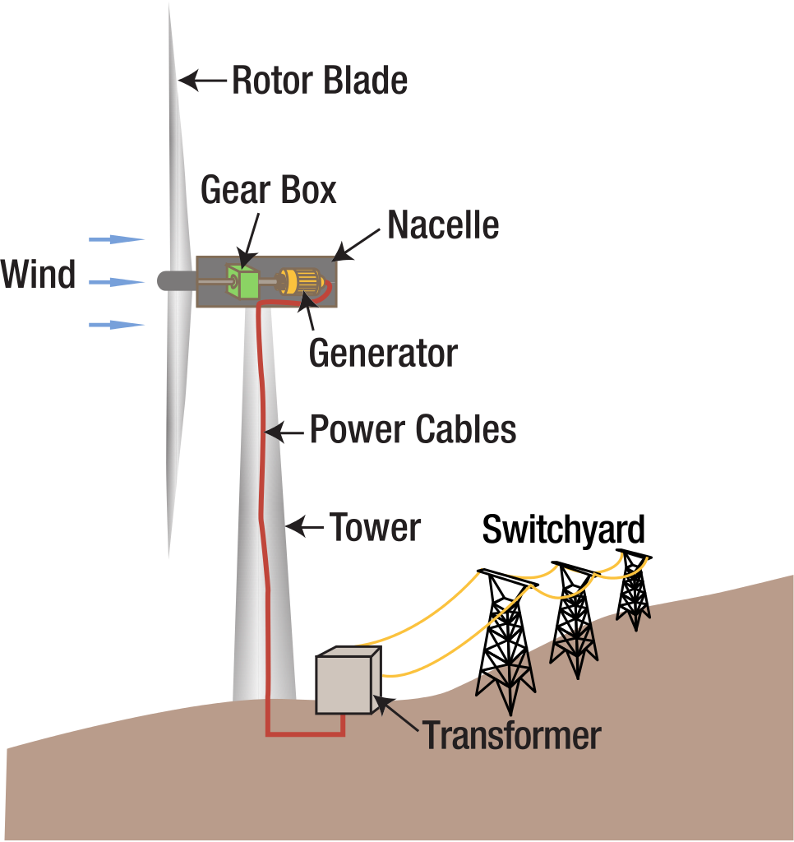
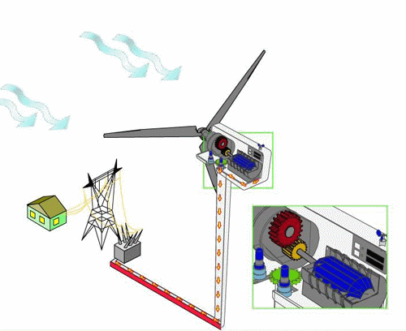
Wind Energy
We use wind turbines to get energy from the wind.
Wind turbines
turn the force of
the wind
into electricity.
How do they
do it?

Slide 16
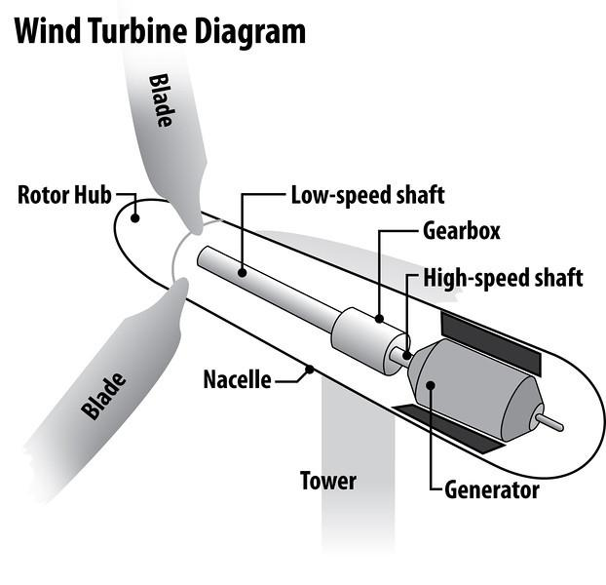
This is how it works:
The force of the wind rotates the blades
The blades are connected to a gear box (by a rotating shaft)
The gear box is connected to a generator (by a rotating shaft)
The generator spins creating electricity!!
Electricity is sent to the power lines

Slide 17
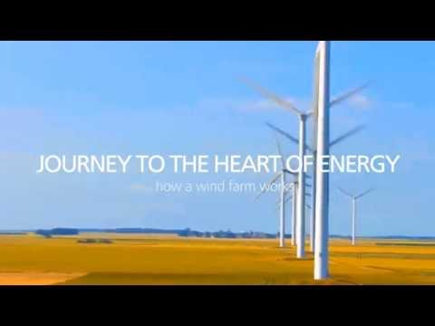

Slide 18
Wind Energy
ADVANTAGES
DISADVANTAGES
The wind is not always predictable - some days have no wind.
Wind turbines need areas with constant wind.
We need a lot of turbines to make a lot of electricity.
Suitable areas for wind farms are often near the coast, where land is expensive.
Some people feel that covering the landscape with these towers is ugly
It can kill birds..
It can be noisy.
It does not produce any carbon dioxide emissions.
It will not run out: Wind will keep on blowing and it is free.
The land beneath can usually still be used for farming.
Electricity can be generated 24 hours a day as long as there is enough wind.

Slide 19
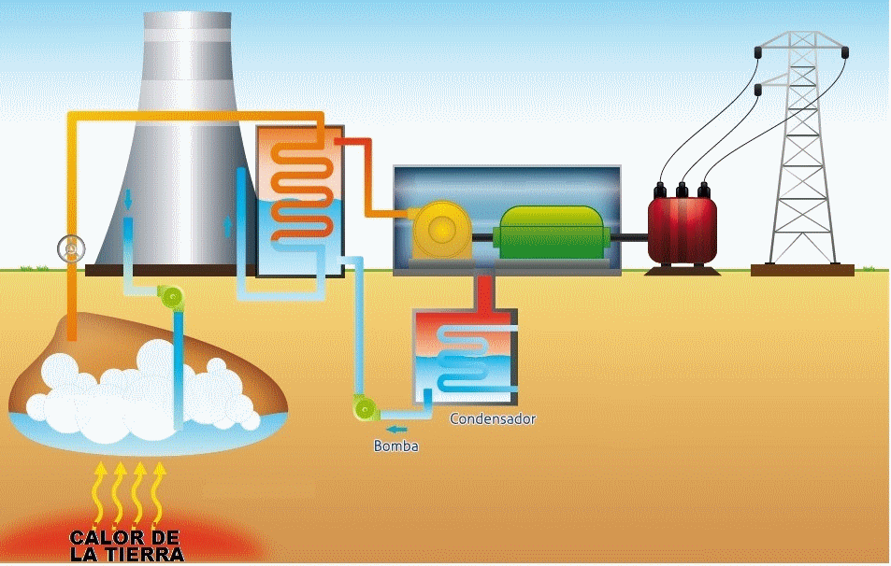
We use geothermal power plants
to get energy from geothermal heat.
Geothermal Energy
(Heat from inside the Earth)
Geothermal stations
use the geothermal heat to generate electricity and to heat houses.
Geothermal stations use steam to produce electricity.
The steam comes from reservoirs of hot water found below the earth's surface.
The steam rotates a turbine that activates a generator, which produces electricity.

Slide 20
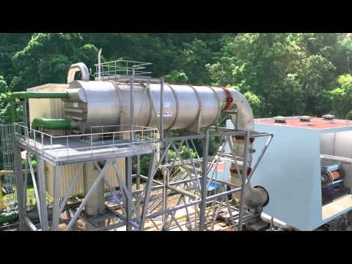
How a geothermal plant works.

Slide 21
Geothermal Energy
ADVANTAGES
DISADVANTAGES
It does not produce any carbon dioxide emissions.
It will not run out: there is heat inside the Earth and it is not going to disappear.
It is independent of weather
Electricity can be generated 24 hours a day
The power stations do not take up much space.
Some dangerous gases and minerals may come up from underground.
There are not many places where you can build a geothermal power station.

Slide 22
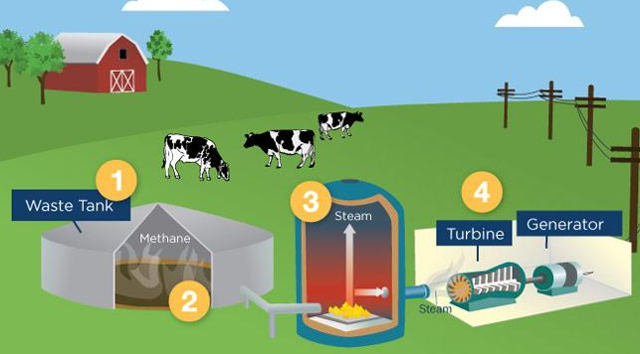
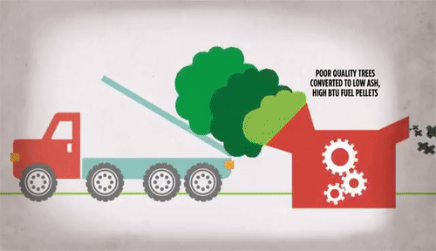
Biomass Energy
We use biomass power stations to get
energy from residues and garbage.
(Organic matter)
Biomass power stations
convert organic matter
into heat and electricity.
Biomass can be burned to heat water and produce steam.
This steam rotates a turbine.
The turbine is attached to a generator, which produces electricity.

Slide 23
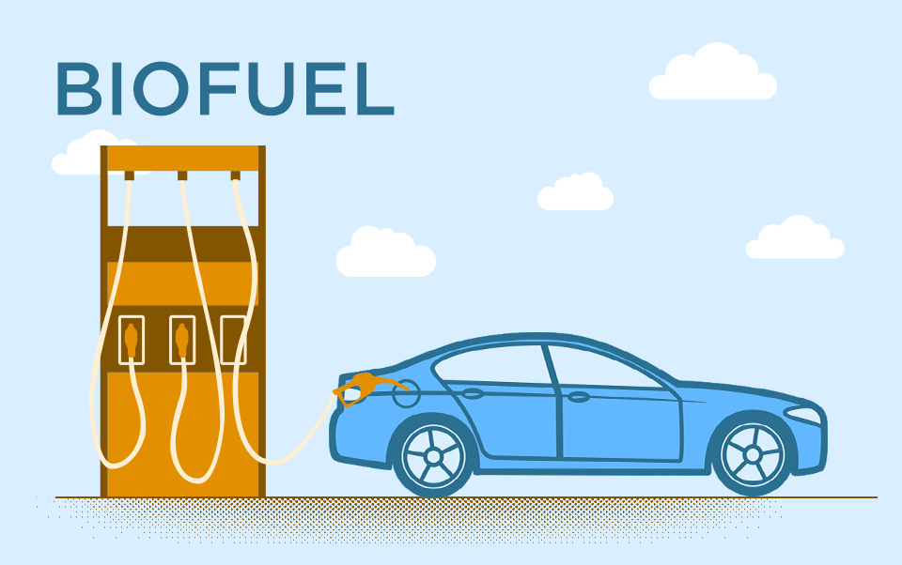
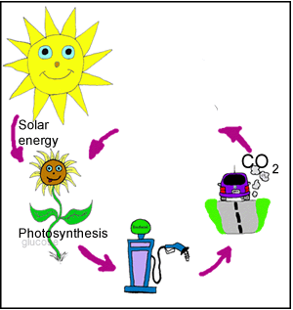
We can also use biomass to make biofuels.

Slide 24
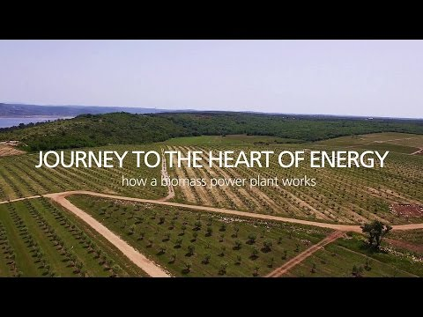

Slide 25
Biomass Energy
ADVANTAGES
DISADVANTAGES
It produces less carbon dioxide emissions than burning fossil fuels.
It will not run out: Biomass is renewable, as long as we have waste products and we grow more crops or trees continuously.
It supports farmers because they can sell their crops for biomass fuel.
It is a smart way to make use of waste.
Collecting and transporting the waste can be difficult and expensive.
Some waste materials are not available all year round.
It can cause deforestation if new trees are not planted.
Some people grow biomass crops where we could grow food.

Slide 26
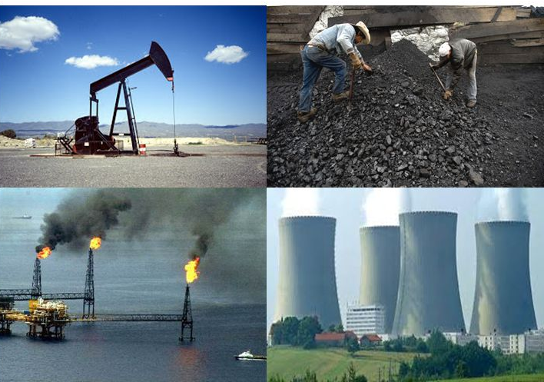
Non-renewable

Slide 27
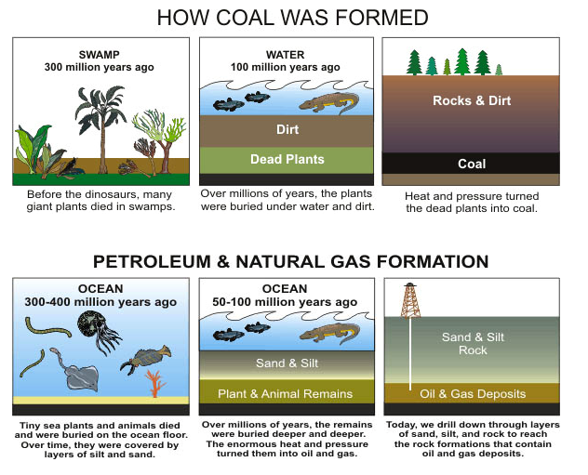
Energy from fossil fuels
Crude oil, coal and natural gas are fossil fuels.
Fossil fuels were formed from dead plants and animals over millions of years. They were buried by sediments and… millions of year of pressure & heat turned them into coal, oil and natural gas.
How coal was formed

Slide 28
Coal comes from dead trees and oil and gas from dead plants & animals.
When we burn fossil fuels, we’re actually using the SUN’S energy that has been stored as chemical energy underground for millions of years!!!

Slide 29
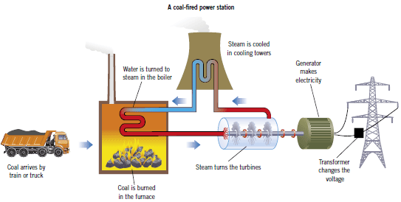
Coal
We use coal to generate electricity in thermal power plants

Slide 30
Coal
ADVANTAGES
DISADVANTAGES
It is found in many places
It can be easily transported to the power stations
It is a relatively cheap energy source
Burning coal produces a lot of CO2 emissions which are harmful for the environment.
It takes millions of years to create coal
Transporting coal by lorry or train from the mine to the power station causes pollution
Coal miners can be affected by lung diseases

Slide 31
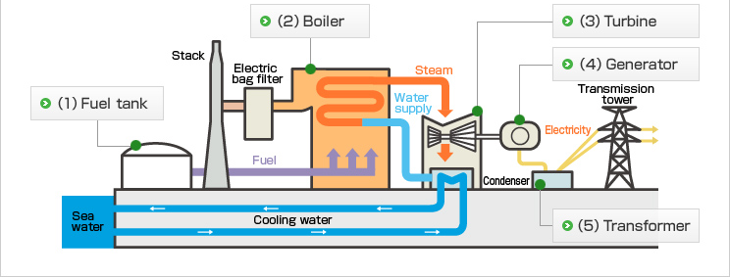
Crude oil
We use crude oil to generate electricity in thermal power plants

Slide 32
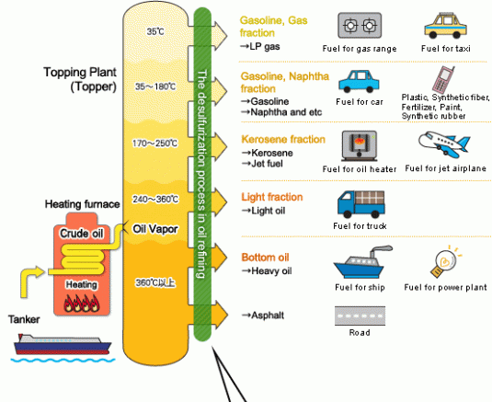
Crude oil
Other uses:
After crude oil
has been extracted from the ground,
it is generally transported to a refinery,
where it is heated
and distilled into
different products.

Slide 33
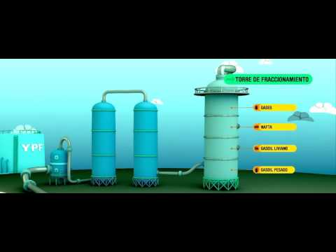
Cómo funciona
una refinería

Slide 34
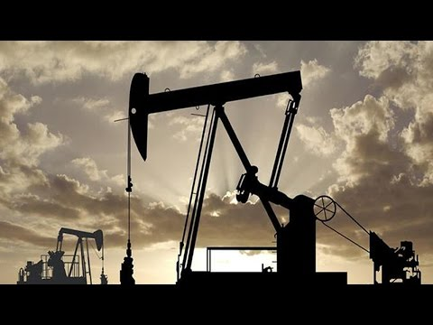
Plastics are
made of...

Slide 35

¿De dónde viene el petróleo?

Slide 36
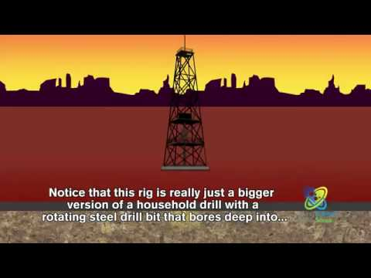
How do we get oil from the ground?

Slide 37
Crude oil
ADVANTAGES
DISADVANTAGES
It is found in many places
It can be easily transported in pipes and by using tankers (ships)
It is non-renewable: once we have burnt it, there isn’t any more.
Burning oil produces CO2 emissions which are harmful for the environment.
If there is an accident like an oil spill it causes a lot of damage to the living things and the environment.

Slide 38
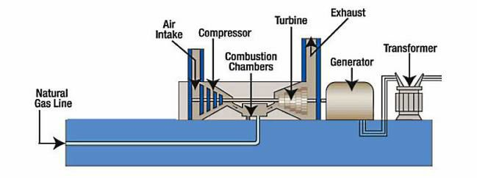
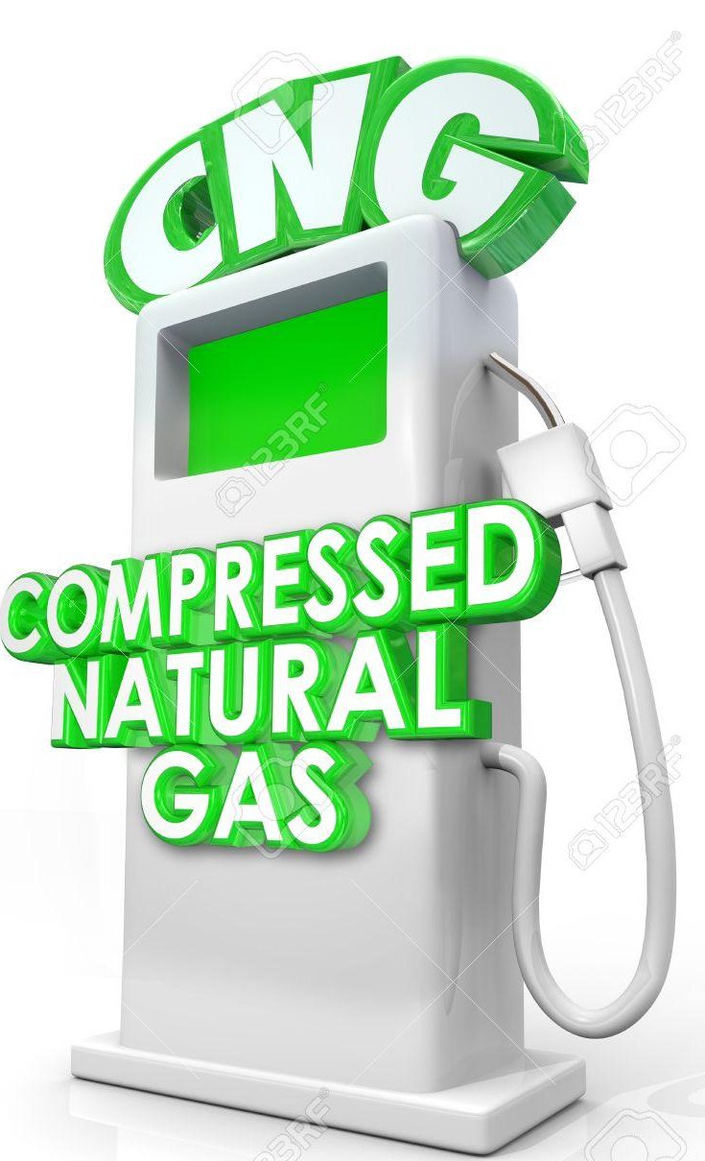
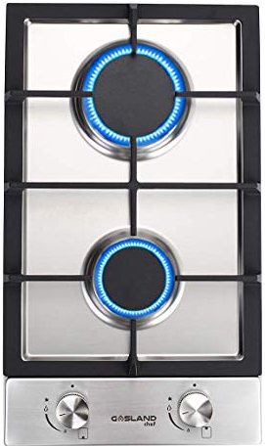
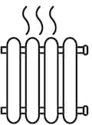
Natural gas
We use natural gas to generate electricity
in thermal power plants
We also use natural gas for
heating systems,
cooking or as a fuel for vehicles.

Slide 39
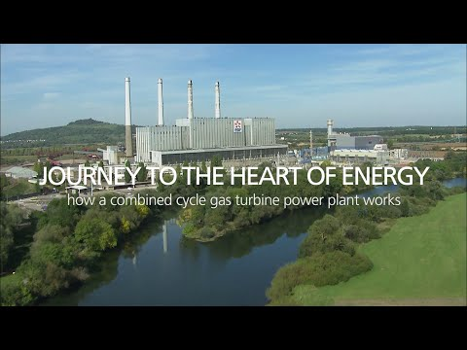

Slide 40
Natural gas
ADVANTAGES
DISADVANTAGES
It is found in many places
It can be easily transported in pipes and by using ships.
It is non-renewable: once we have burnt it, there isn’t any more
If there is a leak, it is not easily detected because of its colorless and odorless and this is dangerous because is highly flammable.

Slide 41
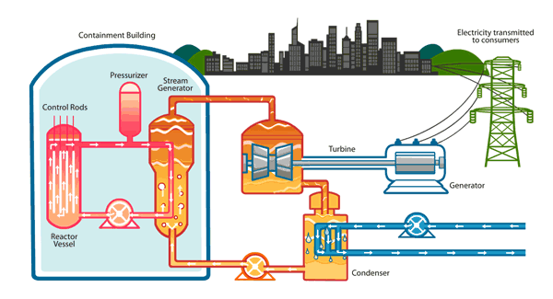
Nuclear energy
We use uranium (a radioactive mineral)
to generate electricity
in nuclear power stations
Nuclear energy is created from splitting atoms.
How do they do it?

Slide 42
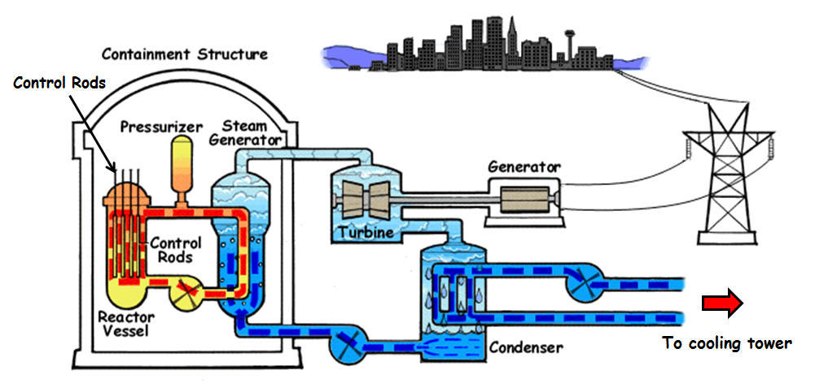
The nuclear reaction inside the reactor releases heat.
The heat is used to make steam
The steam rotates a turbine
The turbine is connected to a generator (by a rotating shaft)
The generator spins and generates electricity!
The electricity is sent to the electric grid
(In this process the steam is cooled down in the condenser and in cooling towers and the water can be reused)

Slide 43

Nuclear plants are placed near big bodies of water.
They need a lot of water:
-to cool the steam and turn it
into water again
-to cool the nuclear fuel after
being used, in a steel pool.
-to cool the reactor in
case of an emergency.

Slide 44

Cómo funciona una central nuclear

Slide 45

How a nuclear plant works

Slide 46
Nuclear Energy
ADVANTAGES
DISADVANTAGES
Unlike fossil fuels, nuclear fuels do not produce CO2 emissions.
You only need a very small amount of nuclear fuel to make a lot of energy.
Like fossil fuels, nuclear fuels are non-renewable energy sources.
If there is an accident, radioactive materials could be release into the environment.
Nuclear waste is dangerous to health for thousands of years.
Nuclear waste must be stored safely.

Slide 47

Nuclear waste is dangerous for thousands of years.
It should be transformed into harmless materials, but we don’t know how.
It is being stored underground.
We haven’t found a better solution.

